Slide 1
DIY Web Archiving
People's Media Camp
October 5, 2025
Rachel Appel
Cynthia Heider

Slide 2
Intros
Rachel Appel, she/her, Digital Preservation Librarian
Cynthia Heider, she/her, Public Digital Scholarship Librarian
What’s your favorite thing to come in a can? 🥫

Slide 3
Session Roadmap
Introduction to web archiving: What is it, and why would you want to do it?
How does web archiving work?
Overview of tools
Live demo of Archive Web.page by Webrecorder and hands-on session
Live demo of Conifer and hands-on session
Live demo of "Save Page Now" by Internet Archive Wayback Machine if we have time
Next steps: Services, resources, projects, and upcoming events
Q&A

Slide 4
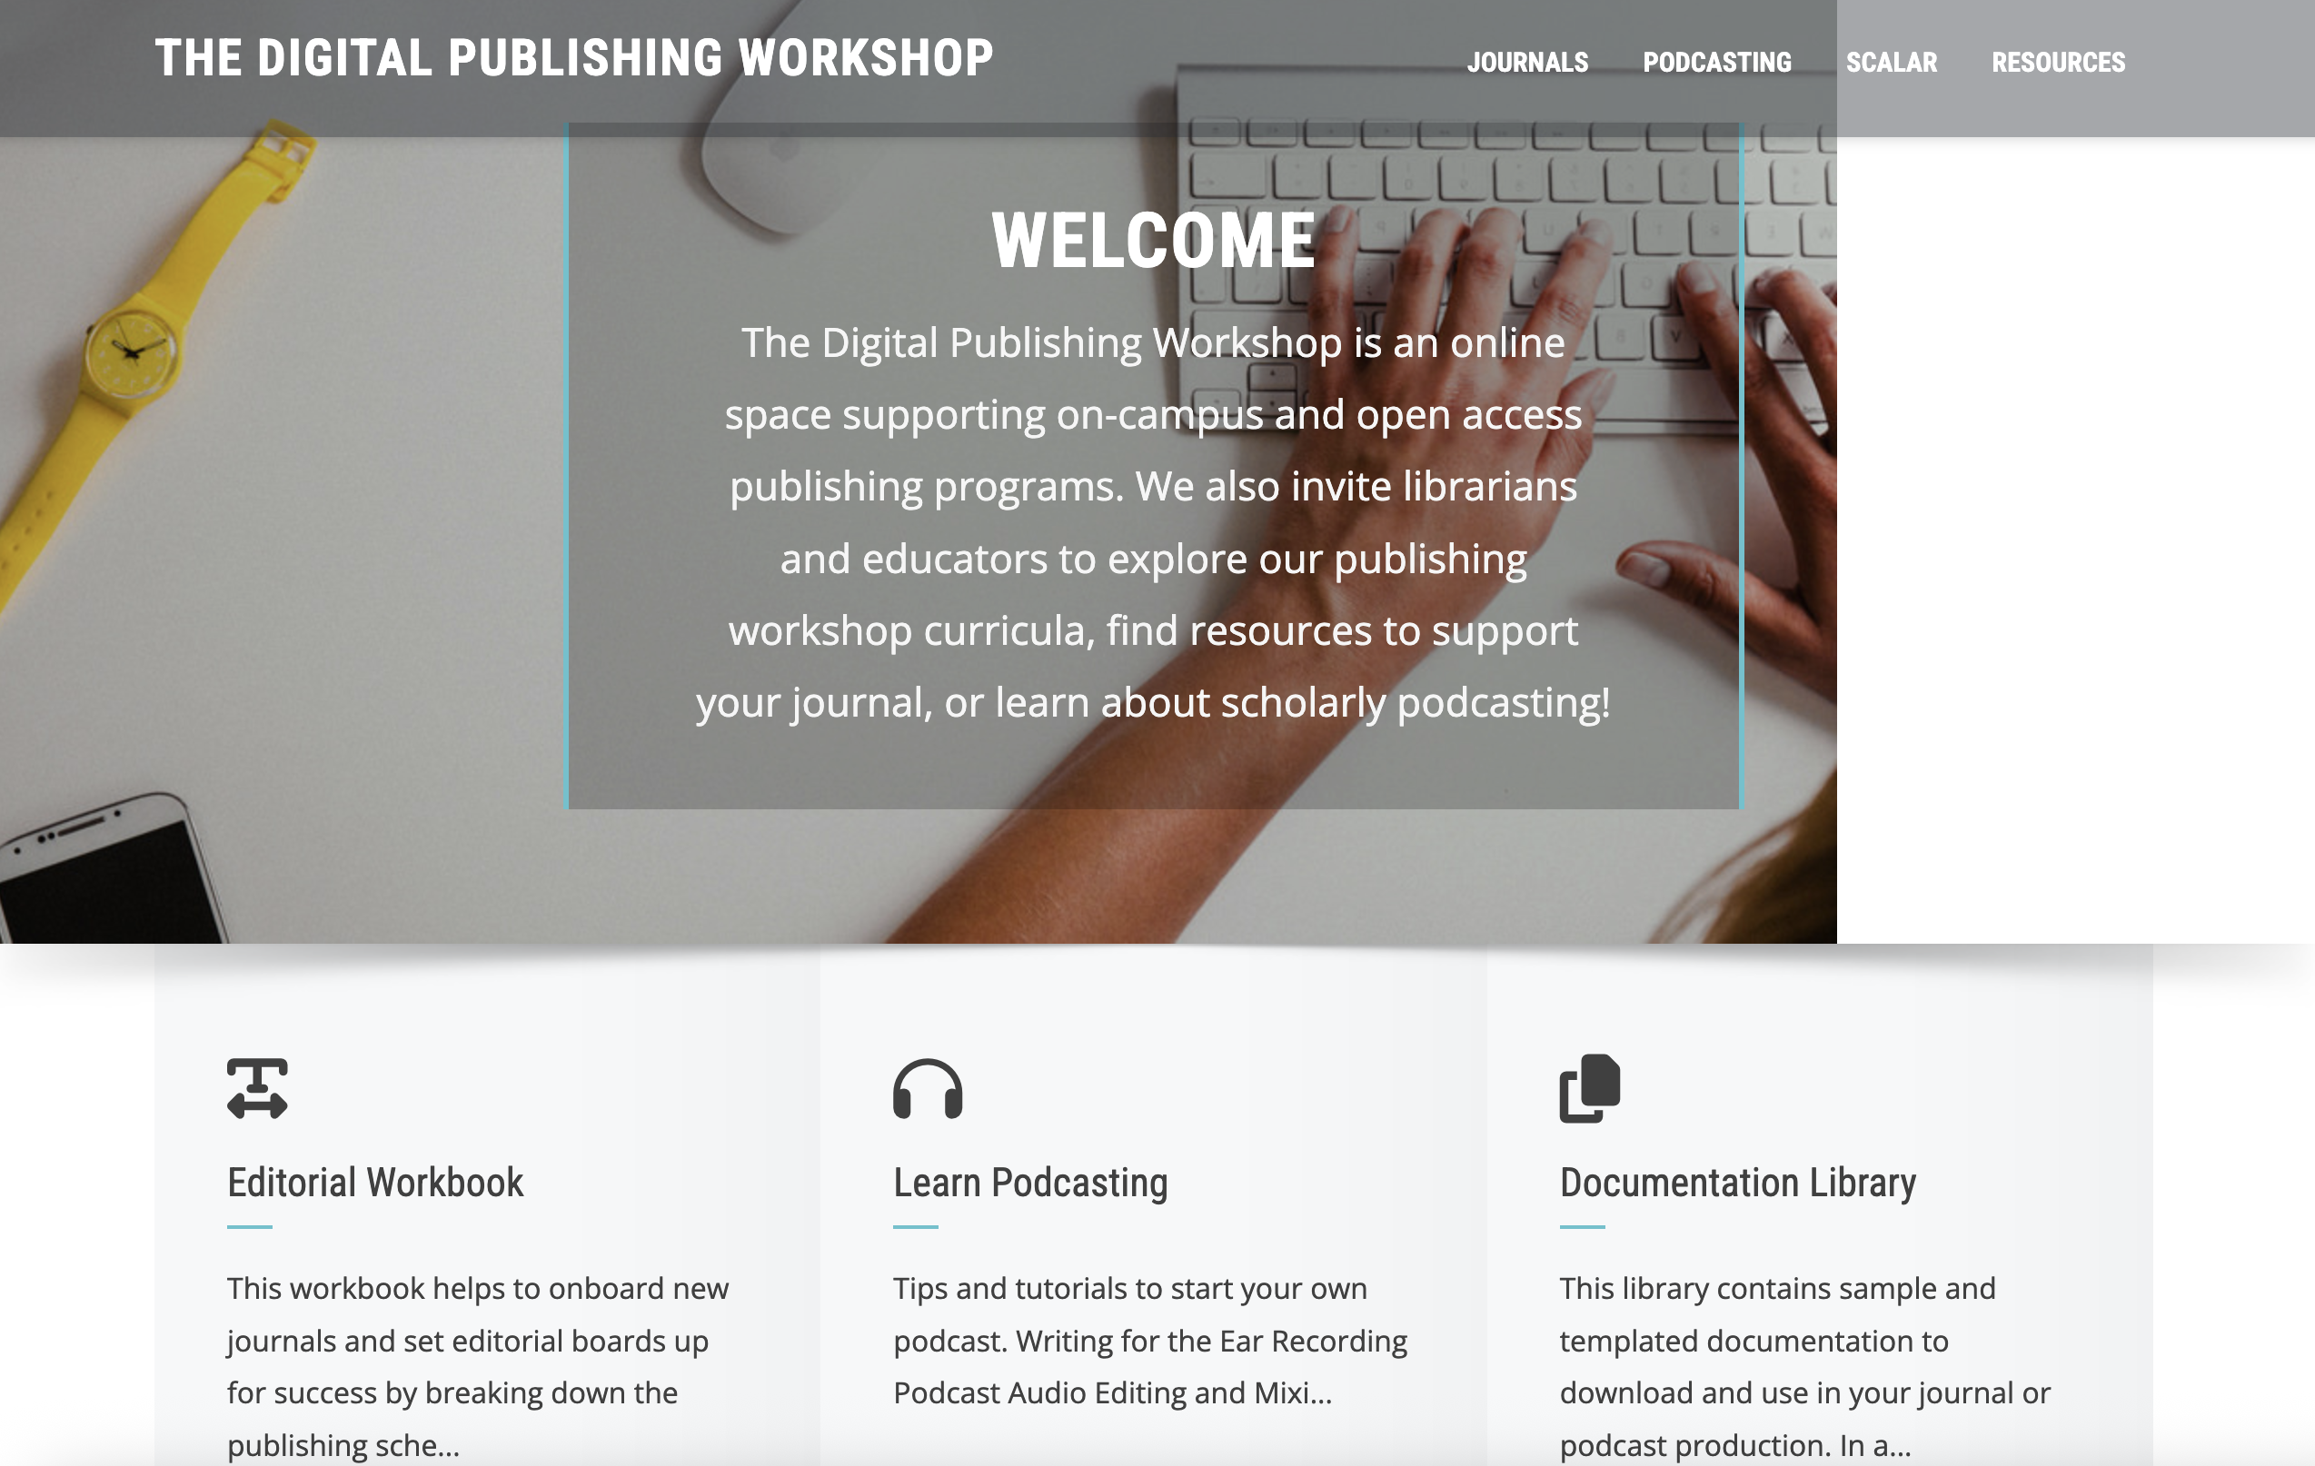
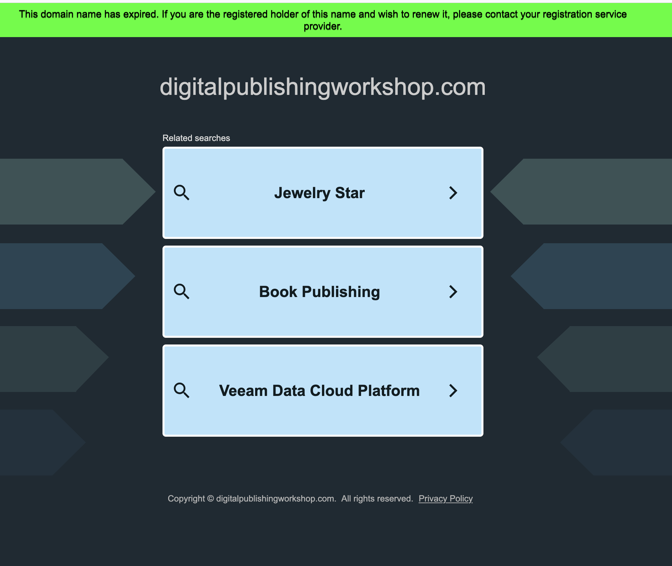
Why web archiving?
Here today...
… Gone tomorrow
Slides available at: http://bit.ly/3WmSeTr

Slide 5
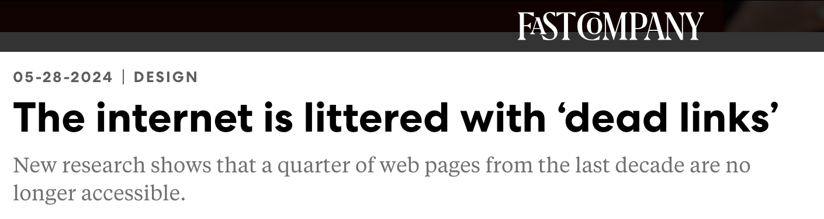
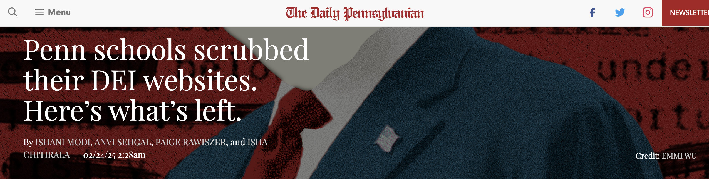
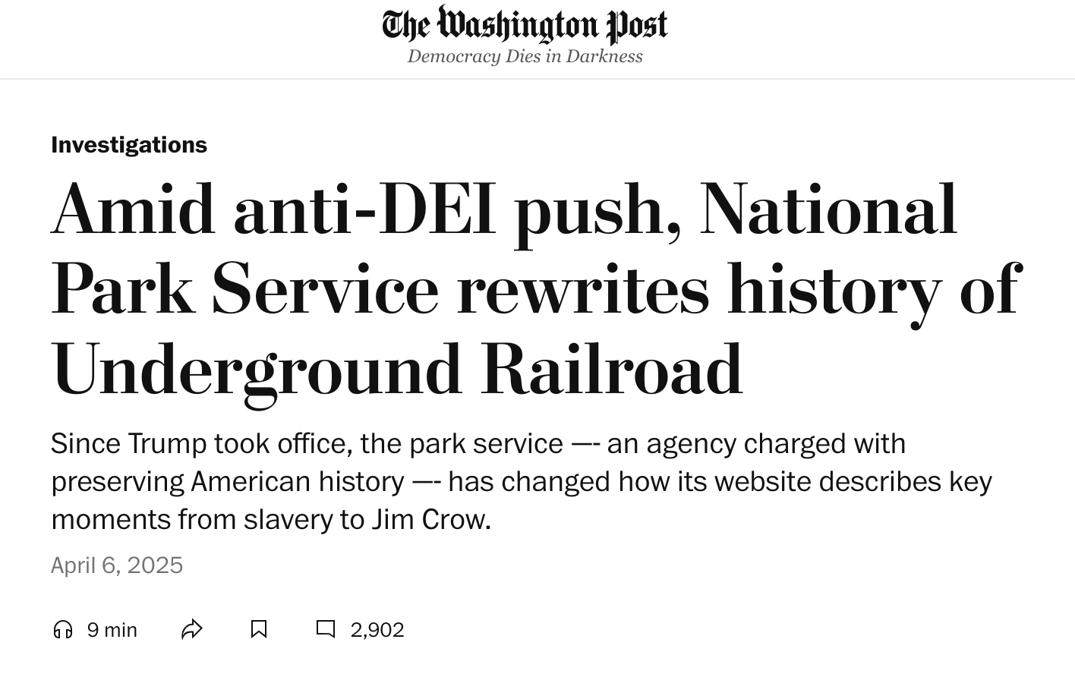
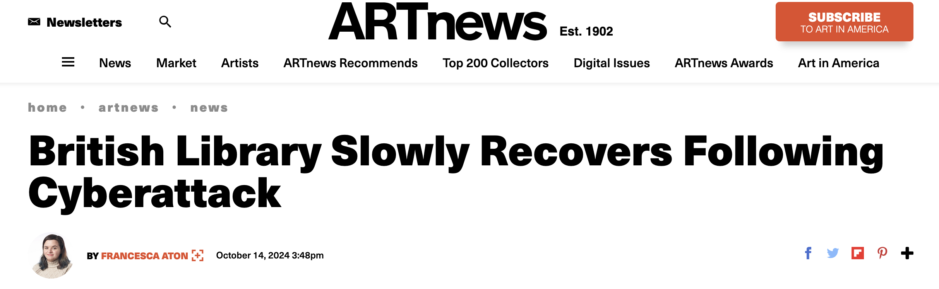
Why web archiving?
"The web is not a storage service – it’s a publication platform." - Sara Day Thomson
Fast Company
The Daily Pennsylvanian
Washington Post
ARTnews
Slides available at: http://bit.ly/3WmSeTr
Notes:
Sara Day Thomson is formerly of the Digital Preservation Coalition.
There are no guarantees that anything will remain online.

Slide 6
What is web archiving technically?
Collecting & preserving online content
Web crawlers capture sites
Stored in WARC format
Replay tools (e.g., Wayback Machine)
Challenges: dynamic, multimedia, storage
Slides available at: http://bit.ly/3WmSeTr

Slide 7
Legal and Copyright Considerations
Copyright applies to online content
Fair use/fair dealing
Website terms may restrict crawling
Hosted platforms (Squarespace, WordPress, Wix) add complexity
Platform terms = contract law risk
Institutions set policies, permissions, takedown options
Slides available at: http://bit.ly/3WmSeTr

Slide 8
So many tools, so little time
Paid
Free
Archive-It by the Internet Archive
CivicPlus
Webrecorder
Perma.cc
* Archive Webpage by Webrecorder
* Conifer by Rhizome
WARCreate
Web Curator Tool
WAIL
Heritrix
*we'll be testing these today!
Slides available at: http://bit.ly/3WmSeTr

Slide 9

Archive web.page by Webrecorder
Free, open-source tool
Use Chrome browser extension or download the desktop app
Stores in WARC and WACZ file formats
All data is saved on your computer
Peer-to-peer sharing feature in development
Not for large-scale or automated crawling
https://webrecorder.net/archivewebpage/
Slides available at: http://bit.ly/3WmSeTr

Slide 10
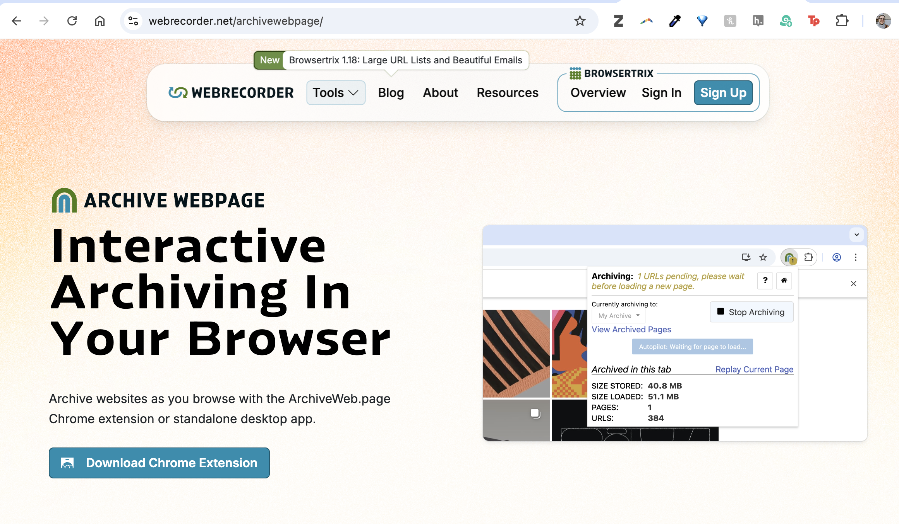
https://webrecorder.net/archivewebpage/
Slides available at: http://bit.ly/3WmSeTr

Slide 11

Conifer
Free, open-source tool
User-driven captures
Saves interactive, dynamic sites
Stores in WARC format
Great for small, detailed projects
Not for large-scale crawling
https://conifer.rhizome.org/
Slides available at:

Slide 12
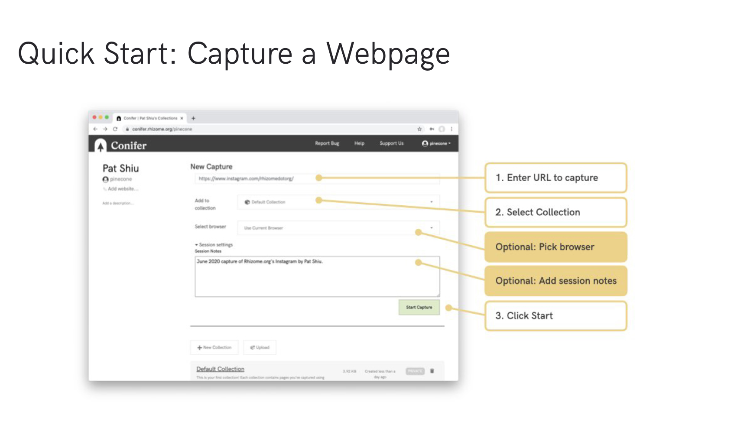
https://guide.conifer.rhizome.org
Slides available at: http://bit.ly/3WmSeTr

Slide 13

Save page now by the wayback machine
Free, tool provided by the Internet Archive's Wayback Machine
Archives a live web page and create a permanent link to its archived version
https://web.archive.org/save
Slides available at: http://bit.ly/3WmSeTr

Slide 14
Hands-on Activity

Slide 15
Services and resources
Community Webs from the Internet Archive
Community Webs Web Archiving 101 training with videos and reference materials
Wayback Machine version of NC State University Libraries Social Media Archives Toolkit
Personal digital archiving of social media info (University of Missouri)
Council of State Archivists video on Social Media & Web Archiving
Zine Bakery DIY web archiving zine
Webrecorder teaching materials (formats, presentations, glossary)
Tools and software list from International Internet Preservation Consortium
Slides available at: http://bit.ly/3WmSeTr

Slide 16
Cool Projects and initiatives
Human Rights Web Archive
End of Term Web Archive
Saving Ukrainian Cultural Heritage Online (SUCHO)
Invisible Histories Project
Archiving the Black Web
Slides available at: http://bit.ly/3WmSeTr

Slide 17
Upcoming events of interest
October 8, 2025 - Archiving the Black Web webinar series: "Digital Storage, Backups, and Repositories"
October 9, 2025 – International Internet Preservation Consortium: Social Media Archiving Q&A Webinar
October 16, 2025 - #AskAnArchivist Day on social media
October 22, 2025: Internet Archive 30 year celebration: "The Web We've Built"
Slides available at: http://bit.ly/3WmSeTr

Slide 18
Thank you!
Q&A
Rachel Appel (rappel@upenn.edu)
Cynthia Heider (heider@upenn.edu)
Slides available at: http://bit.ly/3WmSeTr

